Slide 1
Limits of Neural Networks

Slide 2
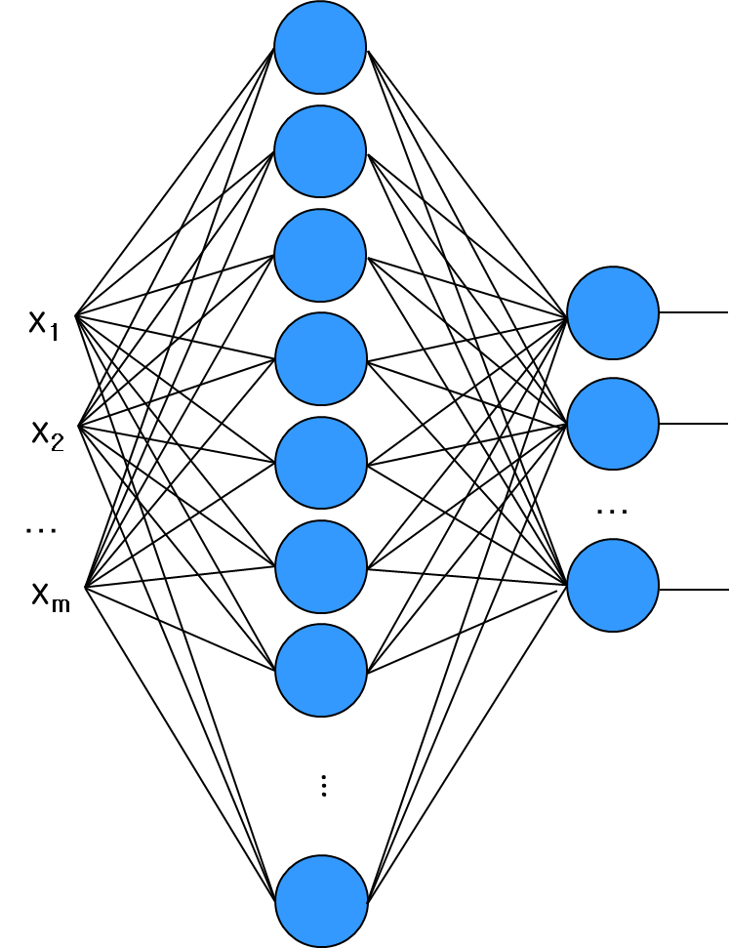
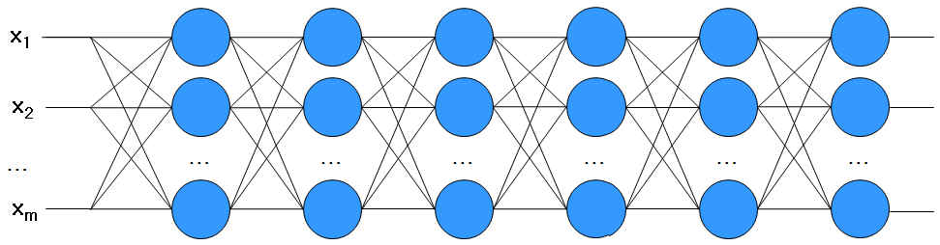
Limits of Neural Networks
Shallow Network vs Deep Network
  Theoretically, it can mimic any functions, but the number of nodes can exponentially increase in a shallow network
  In order to avoid the exponentional explosion, we can adopt deep networks (many layers)
  Deep networks have very strong power but cause many problems!!

Slide 3
Limits of Neural Networks
Pros and Cons of Deep Networks
  Pros: Powers from deep structure
  Cons: Hard to optimize, Overfitting, Internal covariate shift

Slide 4
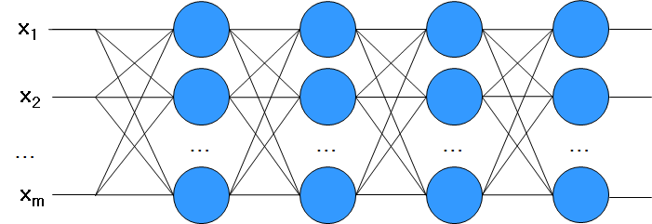
Limits of Neural Networks
Hard to Optimize
  Vanishing Gradient: EBP may not work properly !!
Very SLOW!!

Slide 5
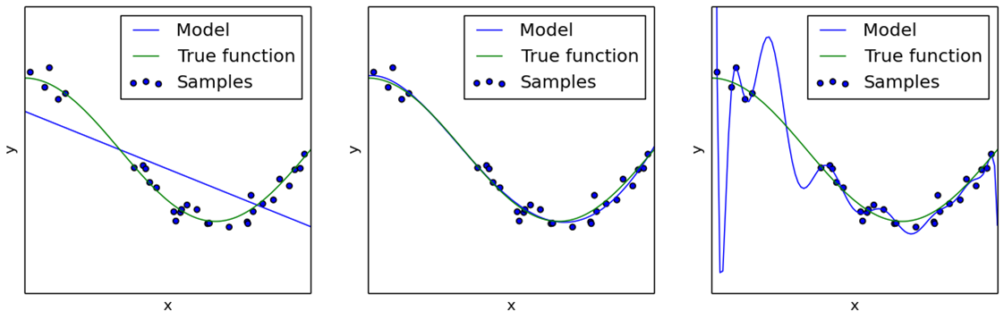
Limits of Neural Networks
Overfitting
Training
Error
Model
Complexity
Low
High
Underfit
Overfit

Slide 6
Limits of Neural Networks
Internal Covariate Shift
  A small change in previous layers leads a large change in the later
Distribution of inputs of a node is easy to shift very fast

Slide 7
Limits of Neural Networks
Solutions
  High Model Complexity
    Adopting deep but relatively simple structures
  Hard to Optimize
    Choosing good initial points
    Using another activation functions
    Mini-batch gradient descent
  Overfitting
    (A huge amount of data)
    Various Regularization Method (including Dropout)
  Internal Covariate Shift
    Batch normalization

Slide 8
Limits of Neural Networks
Structures of Deep Networks
  Fully Connected Deep Networks
    High structural complexity
    Applicable to any data types
    Deep Belief Network, Stacked Denoising Autoencoder, etc
  Partially Connected Deep Networks
    Reduction of complexity targeting to special datatype
    Spatial or temporal sequential data
    Convolutional Neural Networks (CNN)
    Recurrent Neural Networks (RNN)
    Recursive Neural Networks (RNN)

